Slide 1
BetaSplendor Zero
ETSU
Computer Science
Cary FitzHugh
2023-03-08

Slide 2
Contents
1. Prologue
2. Splendor
2.1 Gems
2.2 Development Cards
2.3 Nobles
3. Turn
3.1 Take
3.2 Buy
3.3 Reserve
3.4 TMG
4. The Ending
5. Complexity
5.1 Actions
6. AlphaGo Zero
7. BetaSplendor Zero Pseudo-Code

Slide 3

1. Prologue
Why Splendor?
Fun family game. Tractable strategy, with non-trivial complexity requiring other approaches than simple exhaustive searching.
I am not very good at it, so I can try approaches which don’t require a human genius.

Slide 4
2. Splendor
Players 2 - 4
Engine-Building / Resource Management
Use Gems to Buy… More Gems
Gain enough prestige to win the game

Slide 5
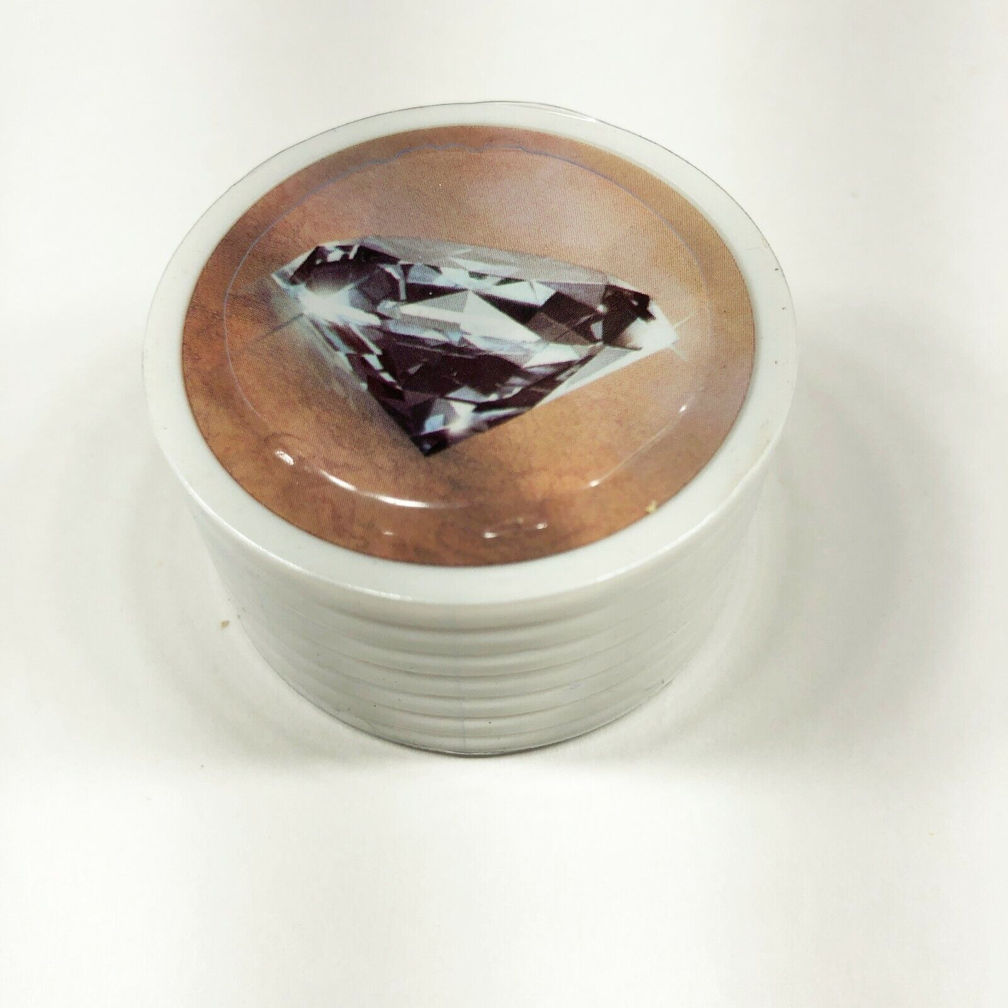
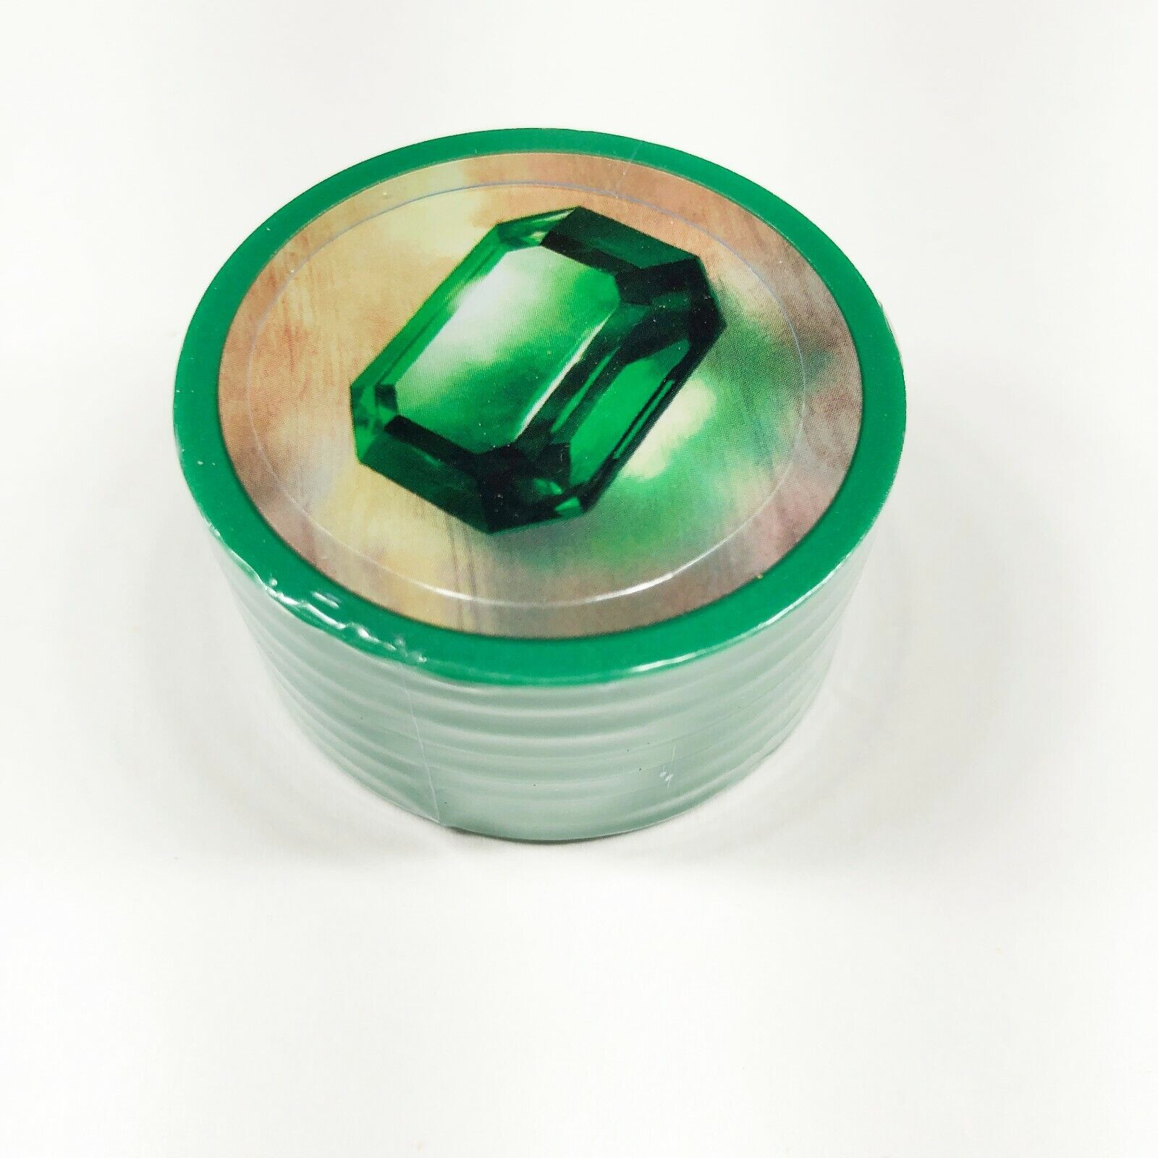
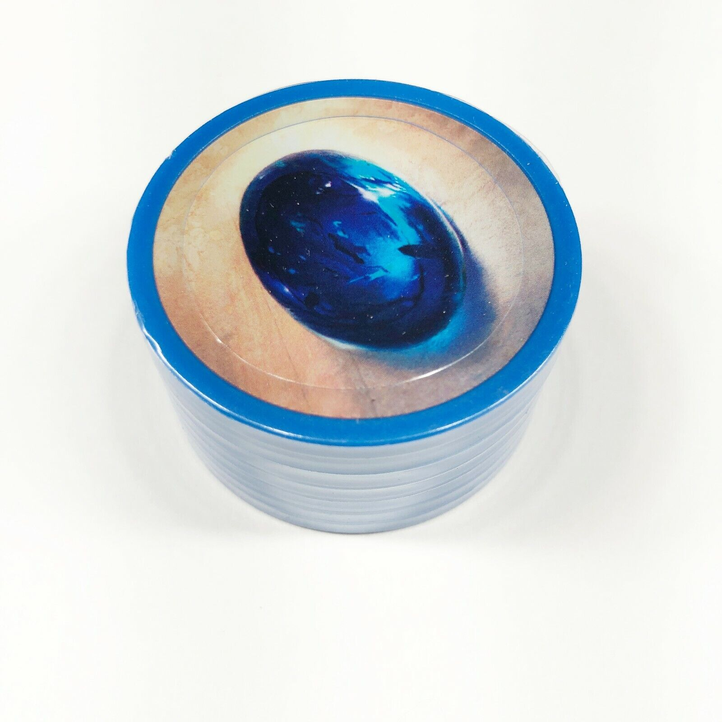
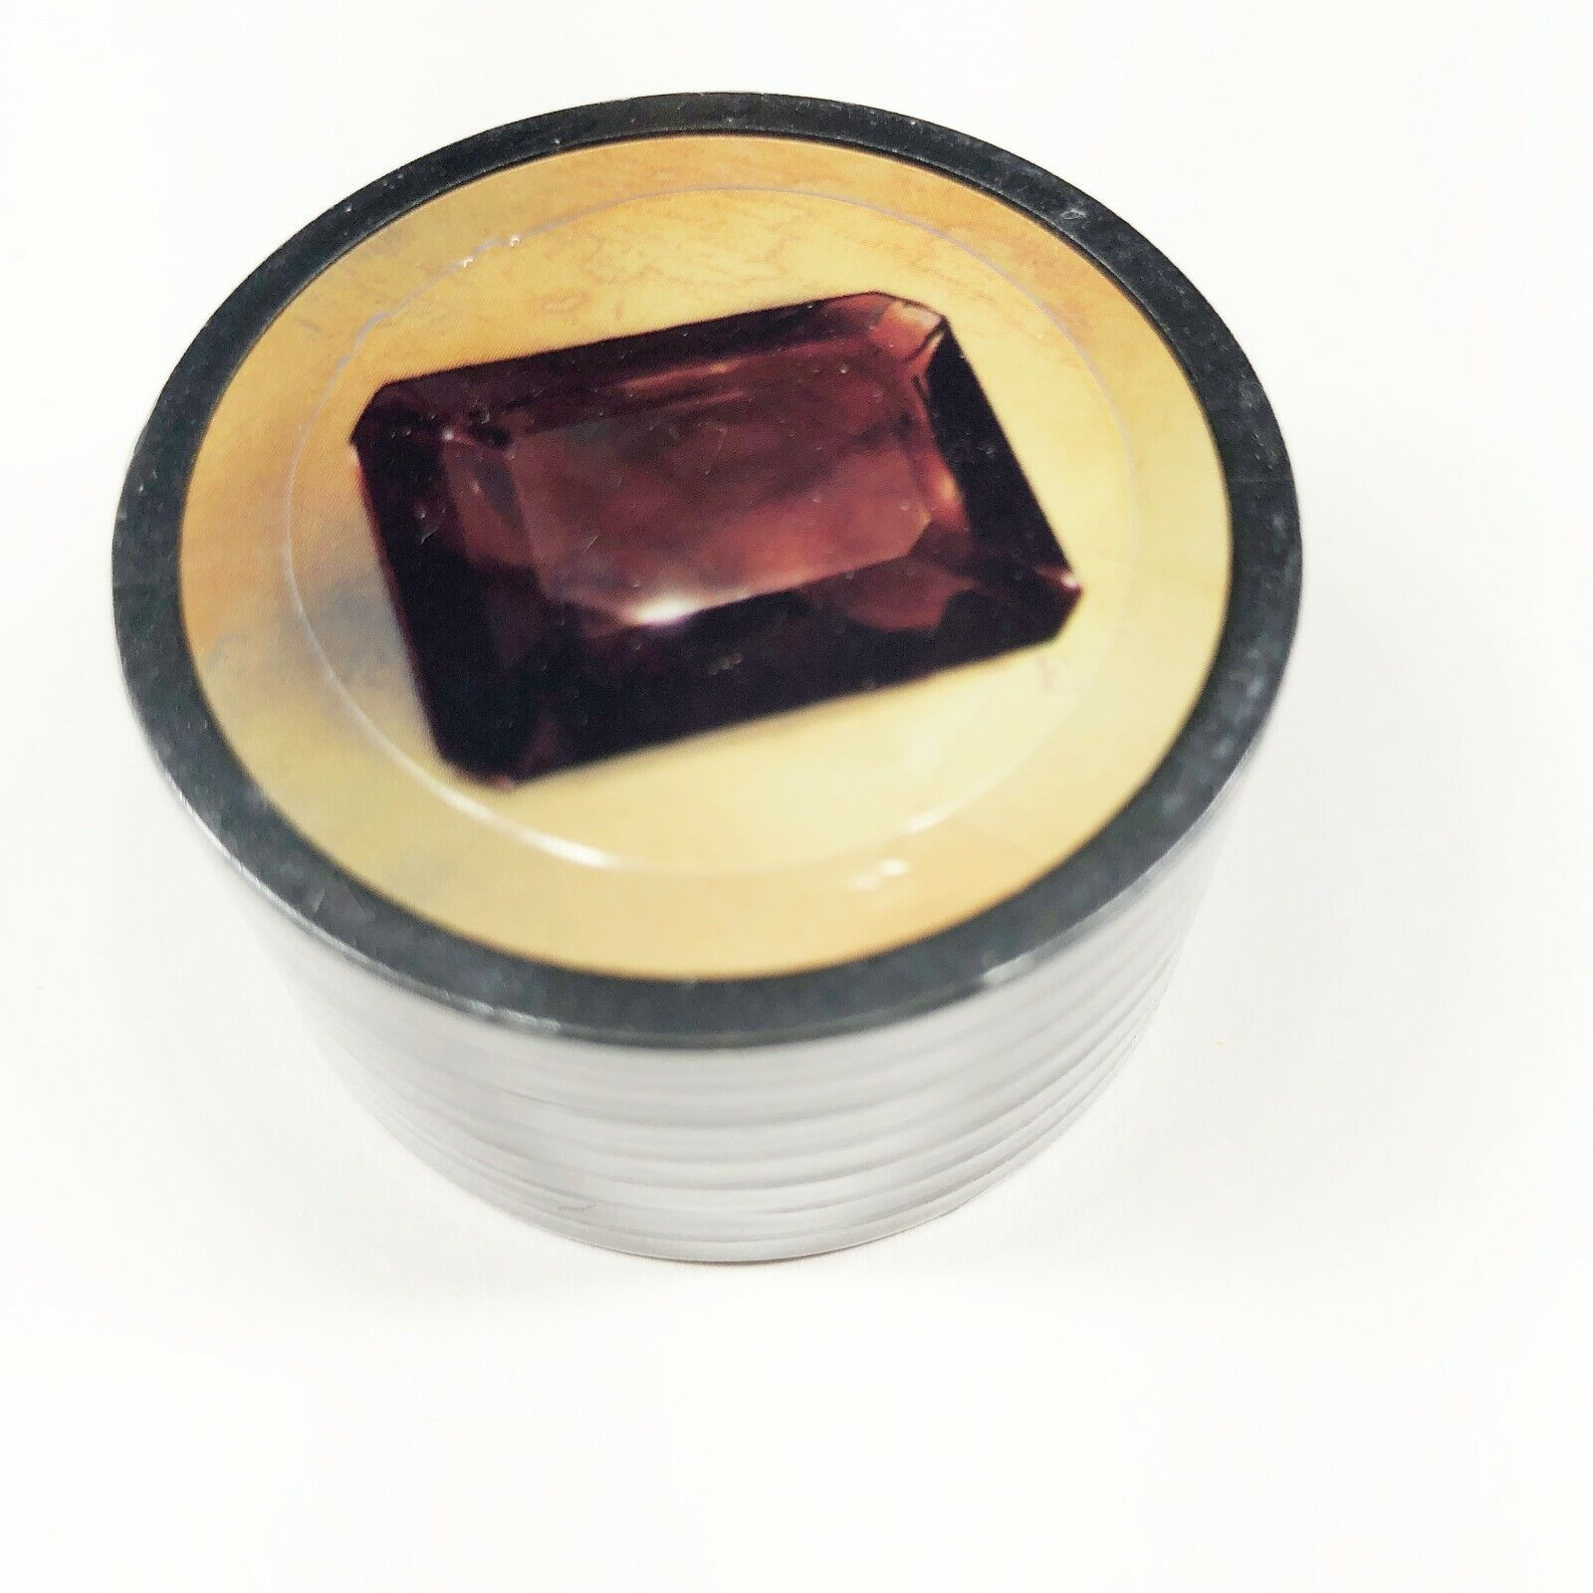
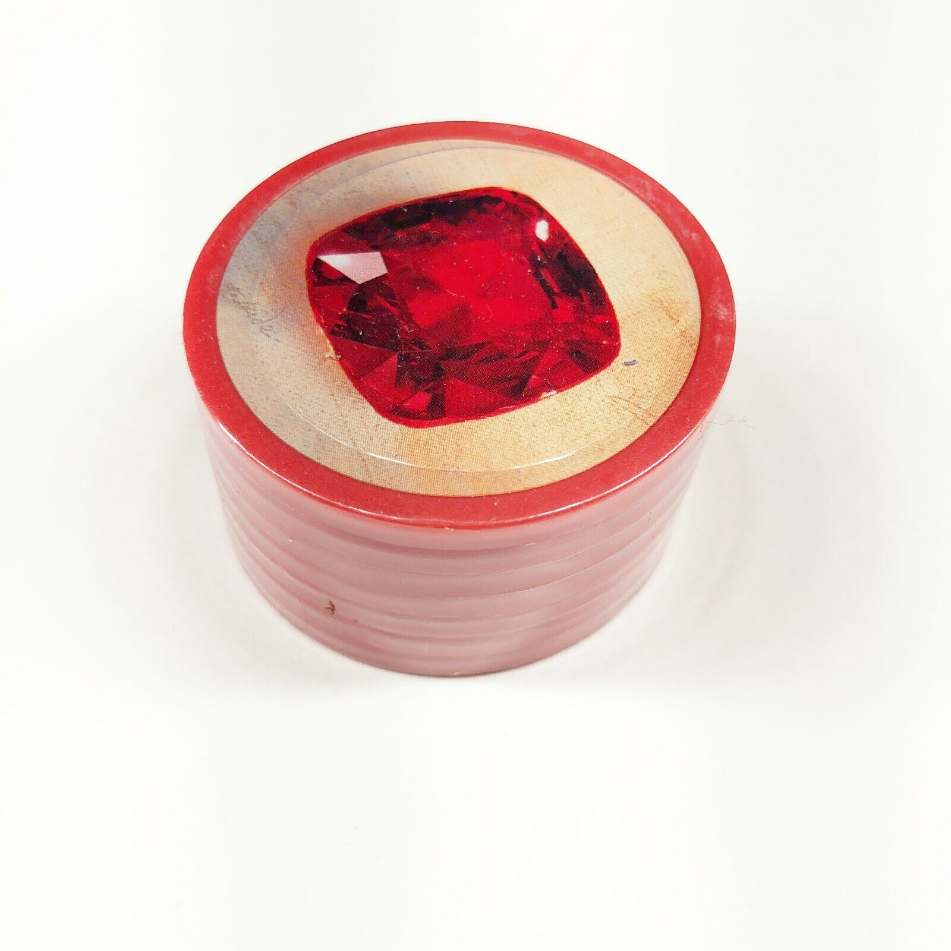
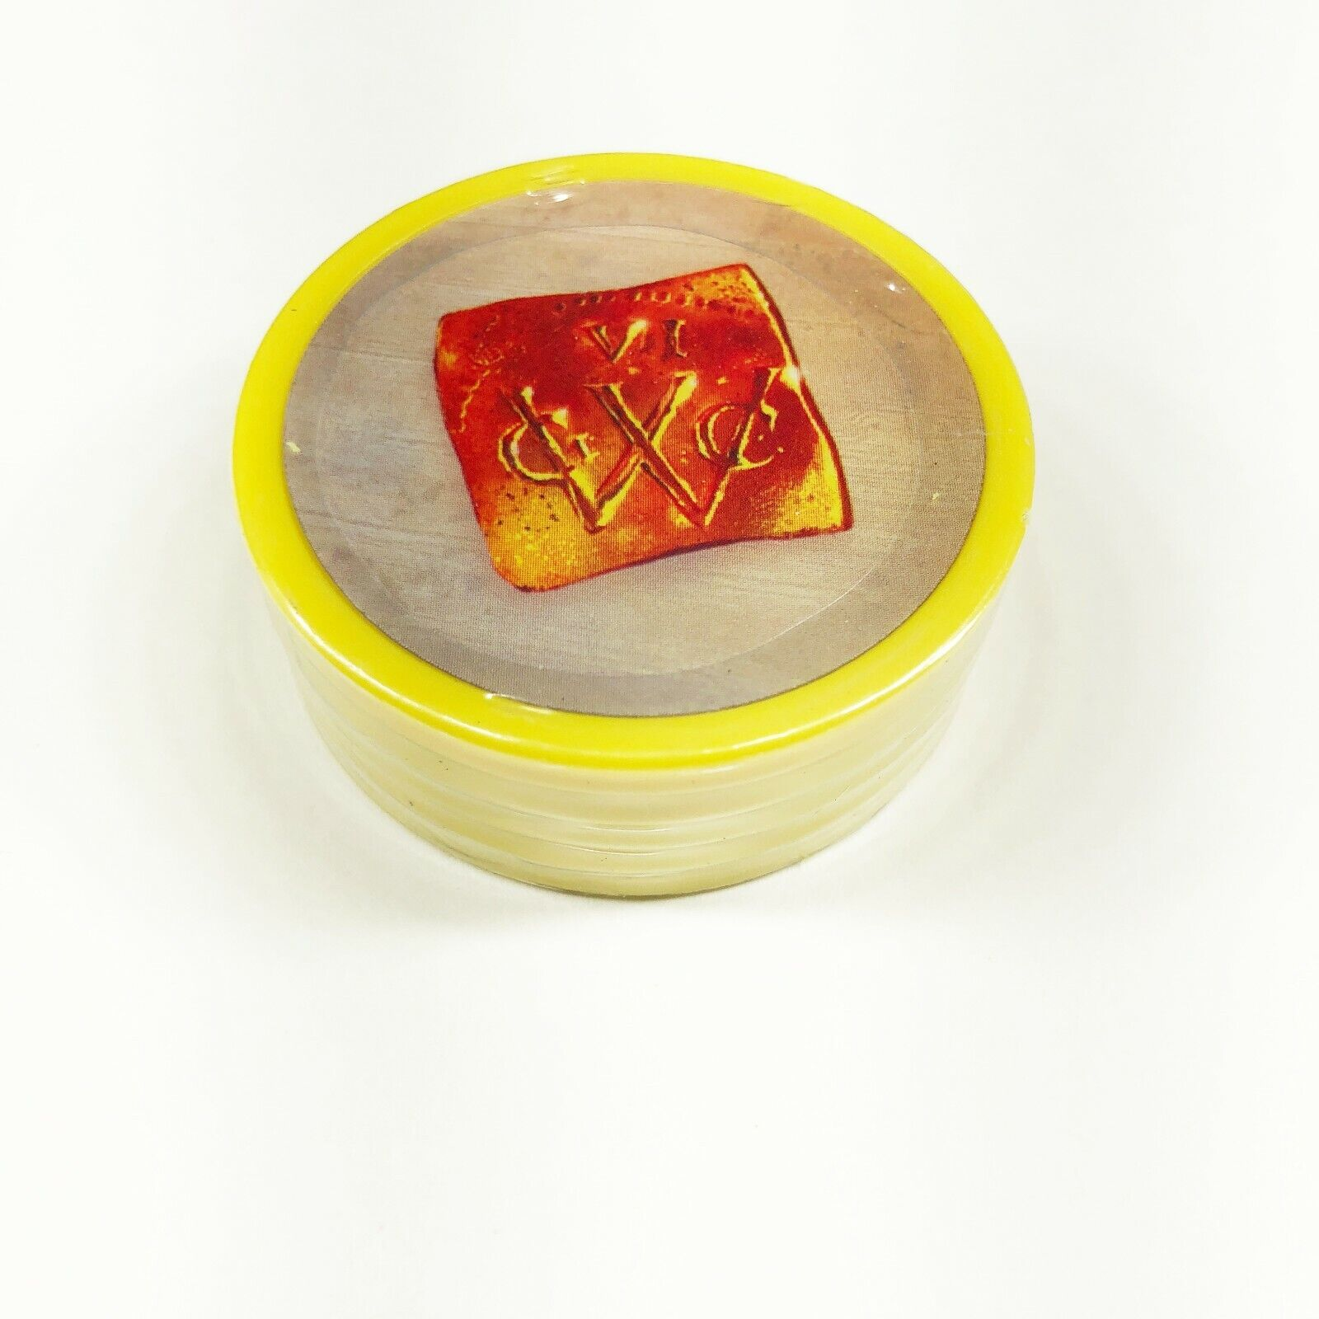
2.1 Gems
Diamond
Emerald
Sapphire (Blueberry)
Onyx (Chocolate)
Ruby (Strawberry)
Gold (Wildcard)

Slide 6
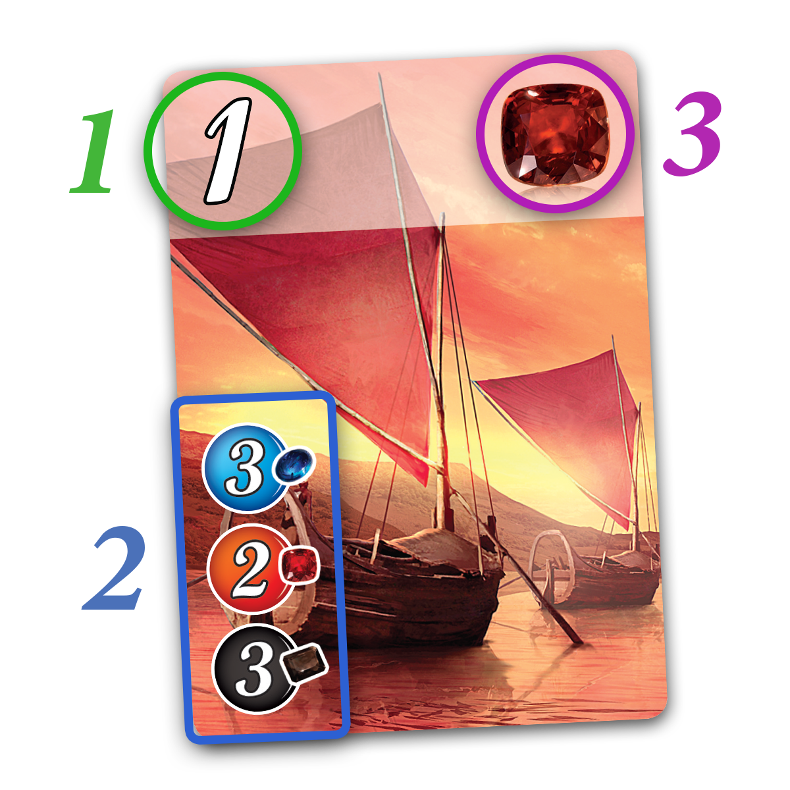
2.2 Development Cards

Slide 7
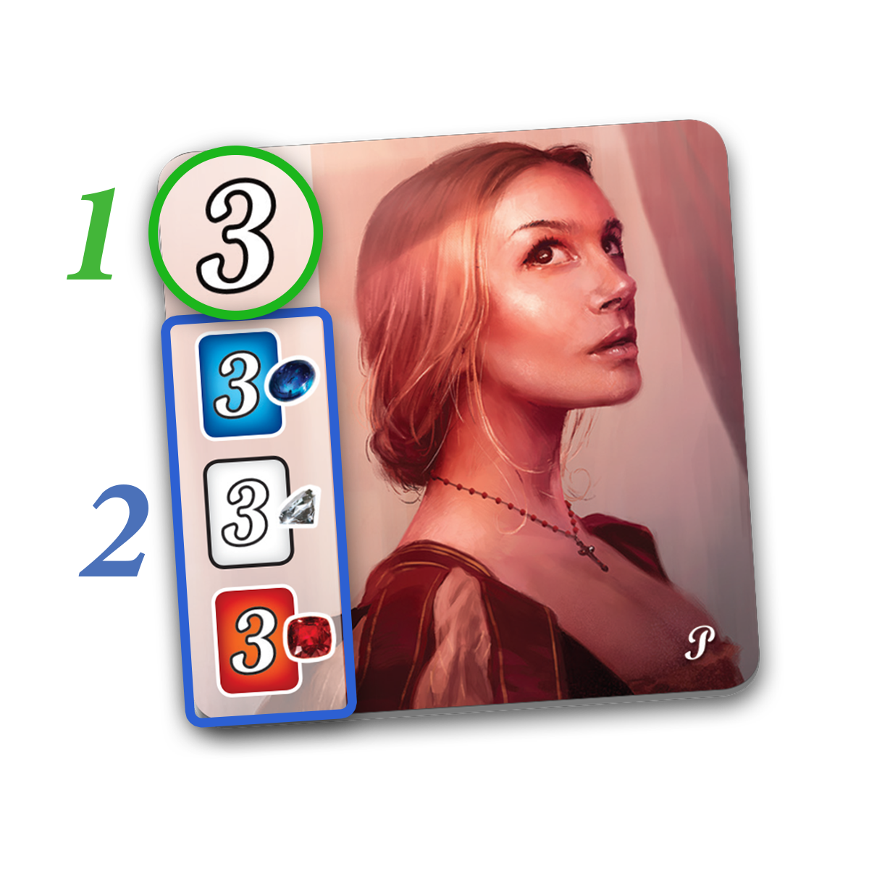
2.3 Nobles

Slide 8

3. Turn
Pickup Gems
Buy a Card
Reserve a Card

Slide 9
3.1 Pickup Gems
Pickup 3 Gems
(Must all be unique)
Pickup 2 of the same kind
(only if there are > 4 left)

Slide 10
3.2 Buy Development Cards
Buy one face up from the table
Buy one that you reserved
Paying with gems + your bonus
Gold is “wild”

Slide 11
3.3 Reserve Card
You can reserve any card on the table.
You can reserve an unseen card from the top of one of the tier decks
You can only reserve 3 cards at a time
When reserving you get 1 gold

Slide 12
3.4 TMG
If you have > 10 gems + gold
You need to return them until you have a valid number.

Slide 13
4. The ending
Play to 15 prestige points
Everyone gets the same number of turns

Slide 14
5. Complexity
~ 40 Available Actions
In one 4 turn round, that is
40⁴ possible states
2,560,000

Slide 15
5.1 Actions
Pick Gem Options
PICK_DSE
PICK_DSR
PICK_DSO
PICK_DER
PICK_DEO
PICK_DRO
PICK_SER
PICK_SEO
PICK_SRO
PICK_ERO
PICK_DD
PICK_SS
PICK_EE
PICK_RR
PICK_OO
Total(15)
Reserve Cards
RESERVE_TIER_0
RESERVE_TIER_0_0
RESERVE_TIER_0_1
RESERVE_TIER_0_2
RESERVE_TIER_0_3
RESERVE_TIER_1
RESERVE_TIER_1_0
RESERVE_TIER_1_1
RESERVE_TIER_1_2
RESERVE_TIER_1_3
RESERVE_TIER_2
RESERVE_TIER_2_0
RESERVE_TIER_2_1
RESERVE_TIER_2_2
RESERVE_TIER_2_3
Total(15)
Buy Card Options
BUY_TIER_0_0
BUY_TIER_0_1
BUY_TIER_0_2
BUY_TIER_0_3
BUY_TIER_1_0
BUY_TIER_1_1
BUY_TIER_1_2
BUY_TIER_1_3
BUY_TIER_2_0
BUY_TIER_2_1
BUY_TIER_2_2
BUY_TIER_2_3
BUY_RESERVED_0
BUY_RESERVED_1
BUY_RESERVED_2
Total(15)

Slide 16
6. AlphaGo Zero
Only uses one NN to calculate
Pwin, PvecAllMoves
Inputs to NN are each position on the go board (19x19 inputs)
Plays games against itself using MCTS, informed by the player’s current NN
The utility of a node for MCTS is calculated by the current NN (or 1 or -1 if terminal leaf)
After each finished game, the networks are trained to reinforce or diminish their affinity for their move history
Once the games have been played and a winner is found, that winning NN is played against the “current best NN” – if it is a substantial winner, it replaces the old best
Do this a lot.

Slide 17
7. BetaSplendor Zero
Uses a single NN
Inputs are each discrete board entity (400+ inputs)
Ouputs are the same as AGZ
Play games against itself like AGZ
Training may benefit from scaling the ‘diminishment’ of a network depending on how badly it lost
Hoping to train 2, 3, and 4 player Networks
I want to add a phase for 3+ player games where the “best current” network is played against each of the latest networks, to try to consider multi-player interactions

